Slide 1
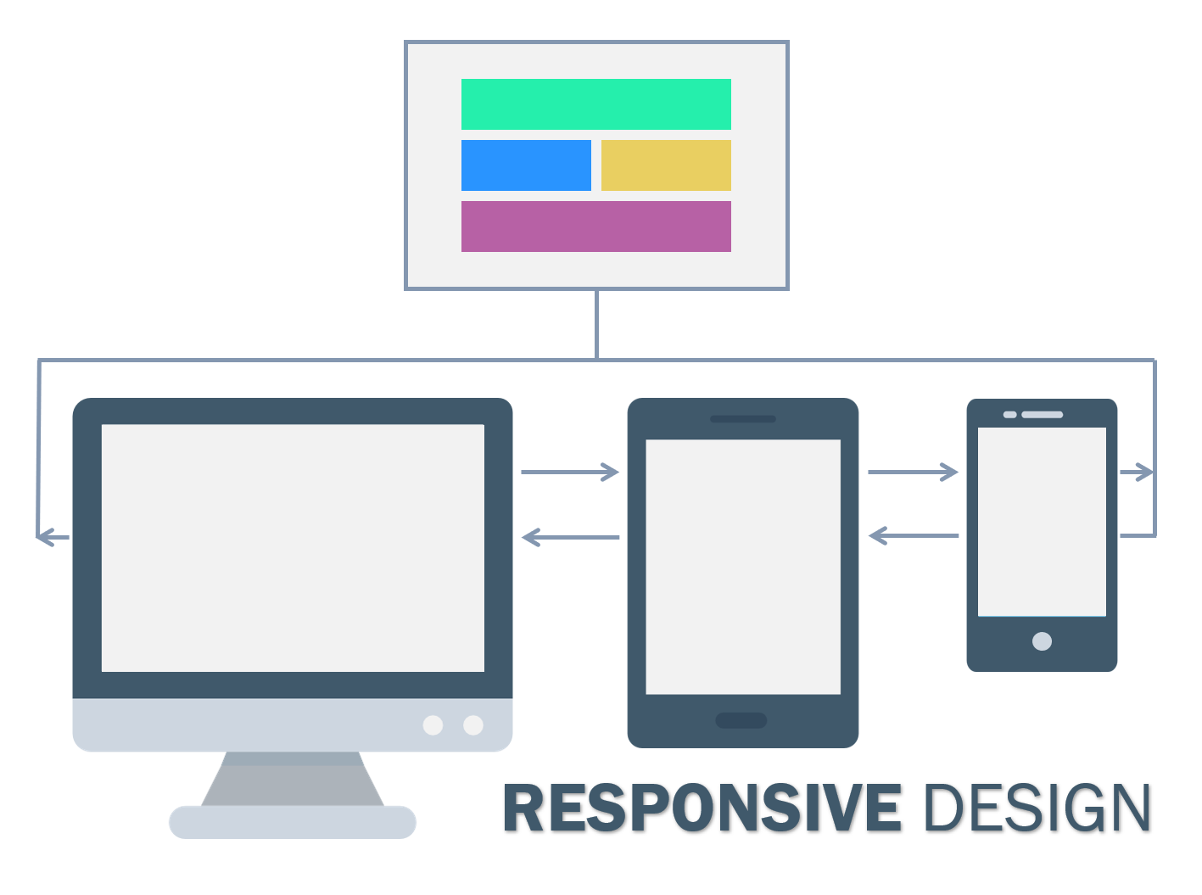
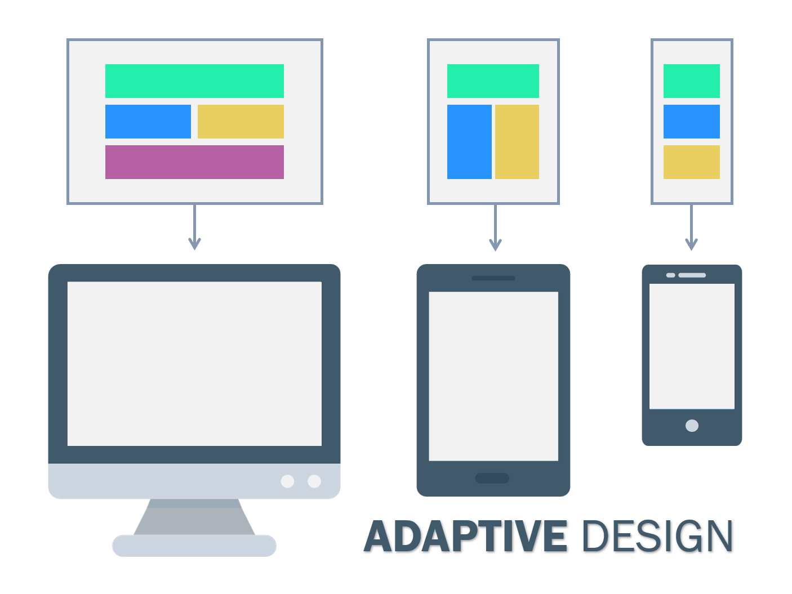

Slide 3
How do responsive and adaptive design compare?
Layout
Load time
Difficulty
Flexibility
SEO friendliness

Slide 4

Advantages of responsive design
Disadvantages of responsive design
Seamless experience
Fewer maintenance tasks
More budget-friendly
Improve crawling and indexing efficiency
More search engine friendly
Slower page loading
Difficulty integrating advertisements

Slide 5
Advantages of adaptive design
Disadvantages of adaptive design
Highly targeted for each user
Faster load times
Optimized for advertising
Reusable existing website
Labor-intensive to create
Harder to maintain
Expensive

Slide 6
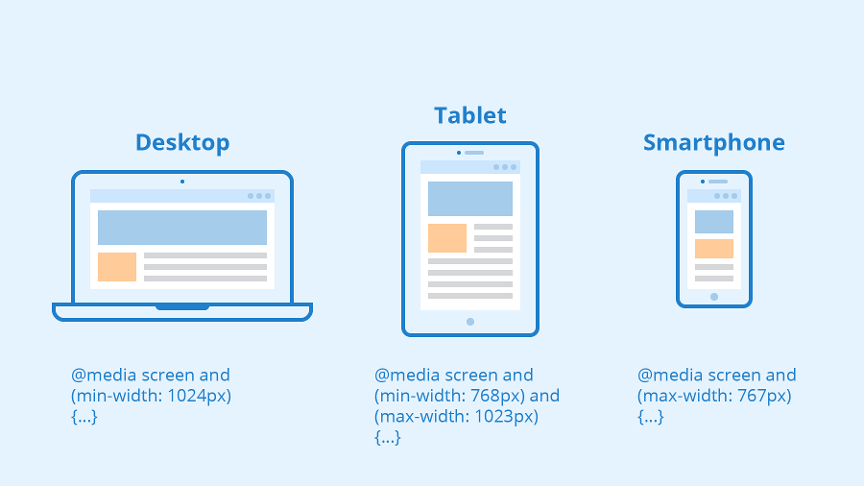

Slide 7
Links
https://html5book.ru/osnovy-html/
HTML youtube
https://flukeout.github.io/
https://flexboxfroggy.com/#ru
https://freebiesbug.com/psd-freebies/personal-website-psd-template-2/
https://freebiesbug.com/psd-freebies/corporate-landing-page/
https://maximwow70.github.io/corporate-landing-page/
https://github.com/maximwow70/maximwow70.github.io/tree/master/corporate-landing-page

Slide 8
Links
https://developer.mozilla.org/ru/docs/Web/CSS/Media_Queries/Using_media_queries
https://ru.bem.info/methodology/

